Slide 1
세상 모든 자연과 통하다
GLOBAL ECO THE SAEM
Eco Soul
Creamy Touch Lipstick

Slide 2
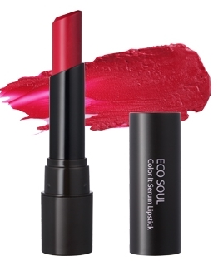
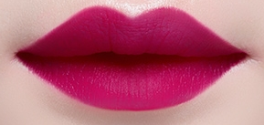
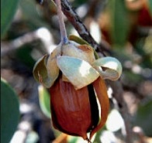
Profile of Eco Soul Creamy Touch Lipstick
PRODUCT NAME | Eco Soul Creamy Touch Lipstick
CONCEPT | Bold, Full-color, Super-lasting, Matte-finish in creamy texture!
Price | KRSP 10,900 won/ 3.5g [ 8 SKU]
TARGET | Customers who disliked the matte, dry texture of Matte-finish lipstick. Customers looking for trendy, vivid colors. Customer who wants light-weight, highly adhesive lip colors in intense pigmentation.
KEY FEATURES | Air-light Texture: Air-light pigments give comfortable feel. Vivid Color Presentation: Bold, stand-out color expression through the natural Color Dispersion System.
INGREDIENTS | Swiss Alpine Herb Complex – Vital and pure energy from the high mountain, fast wound-healing, hydrating. Nuts Oil Complex – Sweet almond oil, Jojoba oil, sunflower seed oil, grapeseed oil, Argan tree oil supply deep hydrations & age-fighting antioxidants to lips. Mild formula, free of 4 additives (Talc, benxophenone, phtalate, triehanolamin)
3. Matte-finish but Comfortably hydrating texture: Most other matte-type lipsticks have drying texture and tend to leave visible lines and flakes on lips. But Eco Soul Creamy Touch lipstick uses ‘Urethan coating powder’ and Nuts Oil Complex to make color glide smoothly and evenly onto lips without skipping,
4. Popular color variation from daily nude to deep, sensual red.

Slide 3
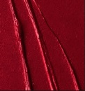
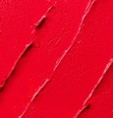
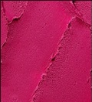
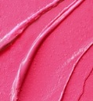
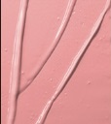
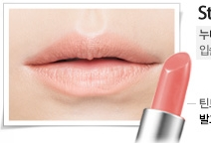
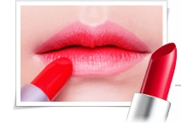
Color Chart & How To Use
Color Chart
01. Come to me Red |  | 05. Spring pink
02. Free Red |  | 06. Brightening orange
03. Daring Pink |  | 07. Unforgettable coral
04. Success Pink |  | 08. Whispering beige
How To Use
&
Other Tips
How To Use
Press lipstick to lips using even pressure to apply color.
For more bold, intense color, apply one more layer.
★ Two-toned lips:
1) Apply Eco Soul Creamy Touch 08 (Whispering beige) on entire upper and lower lips.
2) Apply 03 Daring Pink in the middle of the lips by patting motion.
3) Gently pat with finger for better gradation.
★ Long-lasting vivid but effortless lips:
Pat the lipstick on the middle lips then spread out with finger.
For dehydrated lips,
Use with “Allys Ajell Honey Aloe Essence.”
Use the essence first, let it get absorbed
Now on moist lips, wear creamy touch lips.
Repeat when fixing the makeup during the day time.

